Slide 1
Factors Impacting the expansion into New York City
https://public.tableau.com/shared/GCNS93M8W?:display_count=n&:origin=viz_share_link
To view the Tableau DashBoard

Slide 2
Agenda
Objective
Background
Key findings
Recommendation
Appendix

Slide 3
Objective
Understand New York real estate market
Finding areas where competitors are underserving
Providing early Immediate Recommendation

Slide 4
Background
New York City comprises five boroughs, each with a different level of economic activity and number of residential units
Midtown Manhattan and Lower Manhattan are the commercial centers of New York City. Downtown Brooklyn is a distant second, although growing rapidly.
Brooklyn and Queens have the largest residential populations. The Bronx is also mostly residential.
Each borough is made up of multiple neighborhoods
The commercial neighborhoods are worker destinations, where many of the midlevel jobs are located.
Many people live in the commercial areas, and many short-term rental units are also available.

Slide 5
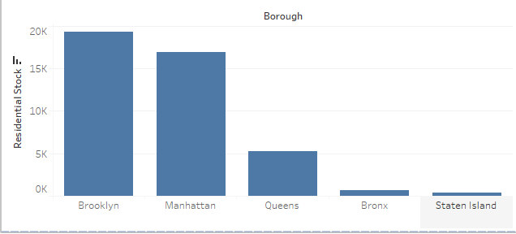
Boroughs having the greatest residential housing stock
Currently Brooklyn is the borough which has the highest residential housing stock followed up by Manhattan.
Queens , Bronx and Staten Island in comparison have very less

Slide 6
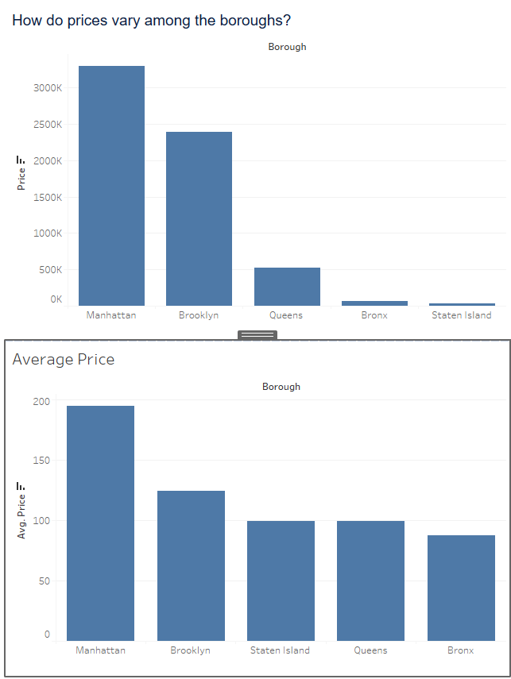
How does Price vary among boroughs
The highest cumulative price as well as highest average price is Manhattan followed up by Brooklyn
But in terms of average Price per unit Staten Island has overtaken both Queens
and Bronx

Slide 7
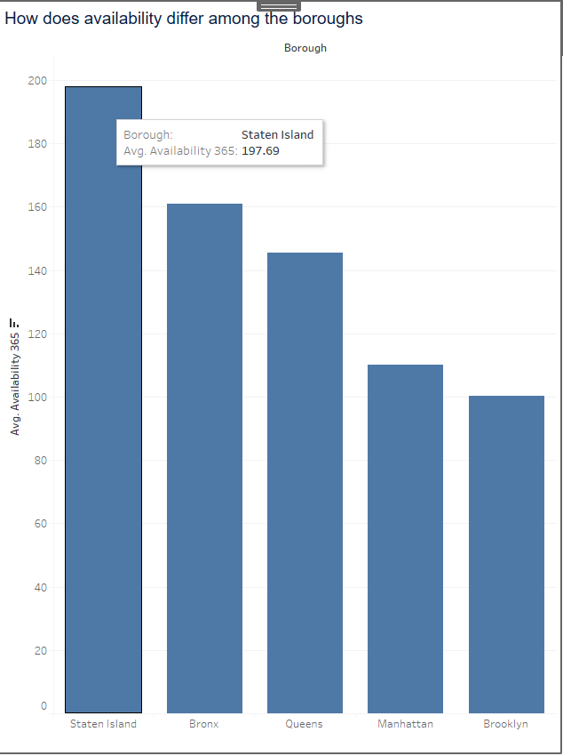
Availability in the boroughs
Leading the charts in being available for most of the year is Staten Island
Followed up by Bronx and then Queens
This means that out of 365 days Staten Island in available for the most amount of time(197 days)

Slide 8
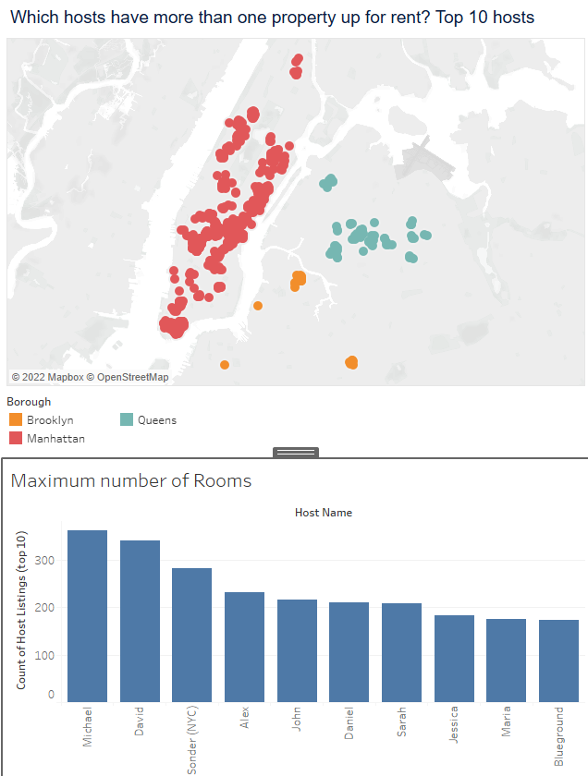
Hosts which have more than one property for rent(top 10)
Here all them are concentrated mostly in the regions of Manhattan , followed up by Queens and then Brooklyn
Here this Maps shows us the list of the top 10 host owners which have the highest number of properties to their name

Slide 9
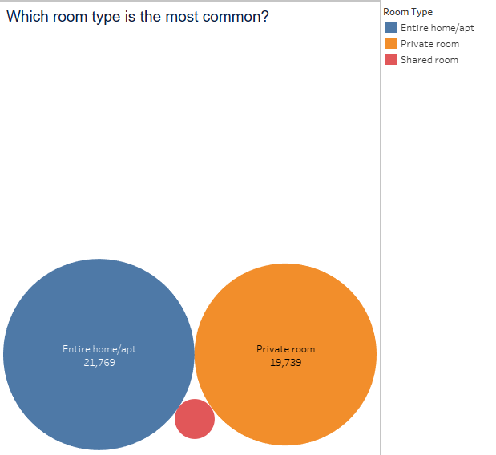
Most common Room Type
Entire home and private room are the most common among the three
But Looking in terms of price Private room and Shared room are relatively similarly priced whereas entire home is way more costlier

Slide 10
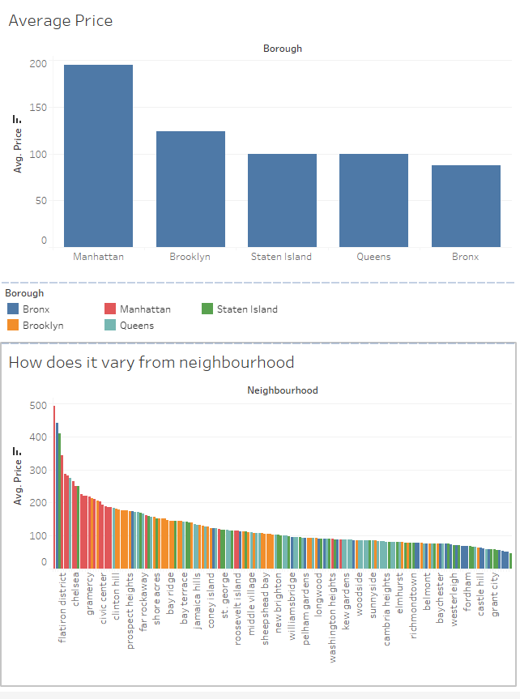
New York City is it Expensive
Yes New York city is indeed expensive and the distribution is as expected with Manhattan being the most expensive according to average price Followed up Brooklyn and then Staten Island

Slide 11
Early Recommendation
We should focus on Private room type as they are abundantly available and provide for a reasonable price
We Should Expand into Queens and Bronx as :-
→they are relatively closer to both Manhattan and Brooklyn which are the main Commercial Areas
In comparison they are also relatively cheaper
Also completion is lower when compared into Manhattan and Brooklyn

Slide 12
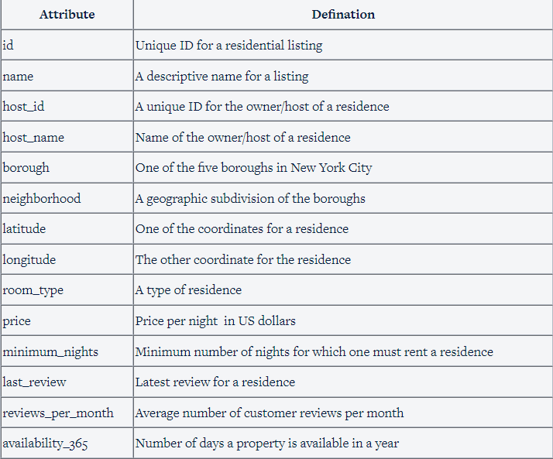
Appendix – Data Sources and Dictionary
Data from
https://raw.githubusercontent.com/som-choudhary/Airbnb/main/Airbnb_new.csv

Slide 13
Data Methodology
I cleaned up the data and filled up the null values
Columns where data is null for the majority are dropped
Values are imputed with mean or median depending upon whether there were outliers

